Slide 1

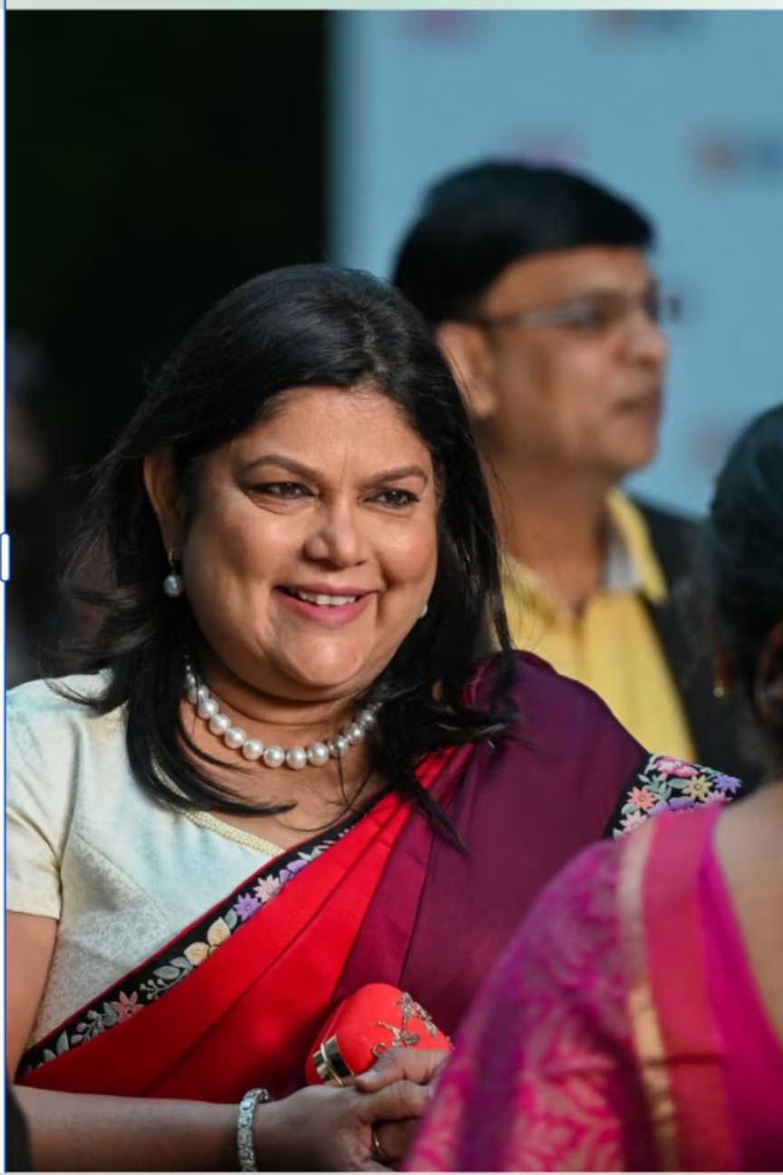

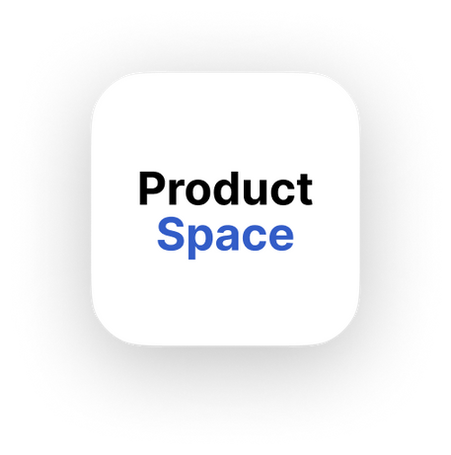


"Nykaa’s Strategic Pivot:
Transforming User Engagement and Building a Dynamic Beauty Ecosystem"
By Vaibhav Bansal

Slide 2
Navigating India's Evolving Beauty Landscape: Nykaa's Strategic Crossroads
Nykaa, once celebrated as the pioneer of India’s digital beauty movement, now stands at a crucial crossroads in its strategic journey. Although the platform has effectively built a strong brand presence among Gen Z and millennial consumers, primarily through its early embrace of online beauty retail, it is now facing a range of significant challenges. These include a clear slowdown in user retention rates, a decline in repeat purchase behaviors, and a growing difficulty in encouraging meaningful engagement from both individual users and emerging Direct-to-Consumer (D2C) brands within its ecosystem.
The initial competitive advantage that propelled Nykaa to prominence is now facing challenges due to heightened competition and shifting consumer expectations. As the market matures, it is imperative for Nykaa to evolve beyond its foundational transactional model. The company must recalibrate its value proposition to ensure sustainable long-term growth and reinforce its market leadership within India's dynamic beauty and fashion sector.

Slide 3
The Engagement Gap: Why Nykaa is Becoming Just a Checkout Destination
Despite boasting a substantial user base and high brand visibility across India, Nykaa's mobile application is increasingly observed to function primarily as a transactional checkout point rather than a vibrant engagement platform. This phenomenon is evidenced by a significant percentage of users who exhibit a sharp drop-off in activity following their initial purchase. Furthermore, the desired pattern of repeat buying behaviour remains weak, a trend that persists even in the face of the company's consistent efforts to incentivize purchases through various offers and promotions.
On the supply side, D2C brands, which represent a significant growth engine in the contemporary retail landscape, are reportedly not thriving as expected on the Nykaa platform. This is primarily attributed to a perceived lack of adequate visibility and insufficient onboarding support mechanisms tailored to their unique needs. In an increasingly saturated and competitive market, where formidable players such as Amazon, Flipkart, and agile D2C brands leveraging social commerce platforms like Instagram are aggressively vying for consumer attention, Nykaa's continued reliance on a purely transactional retail model poses a significant strategic vulnerability. To secure its future growth and relevance, Nykaa must urgently pivot towards becoming a discovery-first, loyalty-driven platform that fosters deeper user and brand engagement.

Slide 4
User Experience Friction Points: Unpacking the "Search-Buy-Leave" Cycle
Through a meticulous personal assessment of the Nykaa application and website, several critical friction points within the user experience have been identified, contributing to a prevailing "search-buy-leave" behaviour rather than fostering exploration and sustained engagement.
Cluttered Homepage
Disjointed Product Categorization
Fragmented Multi-App Ecosystem
The homepage is excessively populated with banners and promotional offers, leading to visual clutter and making the initial navigation experience overwhelming for users seeking specific products or a clear sense of direction.
There is an absence of clear, intuitive segmentation between product categories. This leads to a chaotic display where high-end luxury brands like Dior are presented indiscriminately alongside more affordable D2C brands such as Beardo, creating price confusion and potentially impacting purchasing decisions negatively.
The existence of separate applications for fashion (Nykaa Fashion) and beauty (Nykaa) fragments the overall user journey, diminishing brand continuity and forcing users to switch between platforms for related needs.
Lack of Personalization
Suboptimal Discount Structures
Personalization features are conspicuously minimal. Despite repeated visits and purchase history, the homepage content and product recommendations remain largely static, failing to adapt to individual user preferences and past behaviours.
Discount mechanics are poorly conceived, with a majority of appealing offers only activating on purchases exceeding ₹2000. This contrasts sharply with competitors like Myntra and Ajio, who provide more accessible deals at lower price points (e.g., ₹999), deterring smaller or impulse purchases.
“ Nykaa behaves like Croma – a utility product store. But it wants to be like Myntra or Ajio — a lifestyle experience. That gap is the root of the problem.”

Slide 5
Strategic Redesign: A Curated Ecosystem for Enhanced Discovery and Engagement
Nykaa’s current platform experience fundamentally lacks a structured and aspirational framework necessary to foster deeper user engagement and brand loyalty. To address this, a comprehensive strategic redesign is proposed, built upon a three-part platform model designed to enhance discovery, align with diverse user intents, and provide distinct spaces for different product tiers.
Proposed Platform Model:
Unified App and Enhanced UI/UX:
In parallel, Nykaa must consolidate its disparate applications into a single, cohesive platform. This unified app should feature intuitive smart tabs—such as "Explore," "Gifting," "Premium," or "Routine"—to guide users seamlessly through its diverse offerings without feeling overwhelmed.
Nykaa Luxe
A dedicated portal for global luxury beauty and fashion brands, such as Dior, Estée Lauder, and Givenchy, offering a premium, curated shopping experience with exclusive content and services.
Building an Engagement Layer:
Crucially, Nykaa needs to integrate a robust engagement layer within its platform. This involves incorporating features like short-form video content, creator-led product reviews and tutorials, and peer-to-peer review systems, drawing inspiration from successful models like Myntra Studio or Tira’s recent content initiatives. This layer will transform Nykaa from a transactional storefront into a dynamic hub for discovery, inspiration, and community.
Nykaa Indie
A vibrant marketplace specifically designed for high-growth Indian D2C brands (e.g., Earth Rhythm, Pilgrim, Plum Goodness), providing enhanced visibility, dedicated promotional tools, and community-driven engagement features.
Incentivized Re-engagement
Second purchases within 30 days earn rewards; incentivizes immediate re-engagement.
Attractive rewards or loyalty points for repeat purchases; boosts customer lifetime value.
Nykaa Essentials
A streamlined section focusing on Nykaa’s popular in-house brands and everyday essential beauty and wellness products, emphasizing convenience, value, and routine replenishment.
This strategic segmentation, drawing inspiration from successful models like Ajio Luxe/Ajio/AjioGram, would not only simplify product discovery and match user intent with price sensitivity but also provide each product tier with its own distinct space and narrative, fostering a more curated and less overwhelming shopping experience.

Slide 6




Driving Loyalty and Empowering D2C Brands: The Path to Ecosystem Building
To effectively foster repeat purchasing behaviour and cultivate deeper customer loyalty, Nykaa should strategically refine its discount mechanisms and introduce innovative loyalty incentives. Simultaneously, to bolster its position as an ecosystem builder rather than merely a retailer, it must significantly enhance its support for Direct-to-Consumer (D2C) brands.
Strategies for Enhanced Loyalty & Repeat Purchases:
Empowering D2C Brands: The "D2C Accelerator" Initiative:
Lowered First-Order Entry Discounts: Adjust the minimum purchase threshold for first-order discounts from ₹2000 to a more accessible ₹999. This move aligns with competitor strategies and encourages initial conversions from a wider audience.
On the supply side, Nykaa has a strategic opportunity to become a more attractive and nurturing platform for emerging D2C brands. This can be achieved by launching a self-serve "D2C Accelerator" program.
Initial Free Exposure
Personalized Bundles: Implement an advanced recommendation engine to offer highly personalized product bundles. These bundles can be curated based on individual user data, including skin type, hair concerns, specific routine needs, or defined price ranges, encouraging larger, more relevant purchases.
Provide emerging small brands with initial complimentary homepage exposure, targeted banners, and inclusion in curated D2C-specific collections to boost initial visibility.
Marketing Tool Access
Offer access to a suite of self-serve marketing tools, including template-based ad creation, social media integration support, and limited-time promotional campaign functionalities.
Cashback Window Program: Introduce a "cashback window" where second purchases made within a specified timeframe (e.g., 30 days of the first order) earn attractive rewards or loyalty points. This incentivizes immediate re-engagement.
Performance Analytics
Grant D2C brands access to simplified analytics dashboards, providing insights into sales performance, customer demographics, and product engagement on the Nykaa platform.
Gamified Loyalty Program: Launch a comprehensive gamified loyalty program. This could involve earning points for purchases, reviews, content engagement, or referrals, with tiered benefits, exclusive access to new products, or special discounts. The objective is to significantly increase Monthly Active Users (MAU) and drive higher Customer Lifetime Value (CLTV).
Monetization Model
Future monetization could transition to performance-based co-branding fees or royalty charges once brands achieve significant sales milestones. This model strengthens loyalty among emerging brands by offering clear growth pathways.

Slide 7
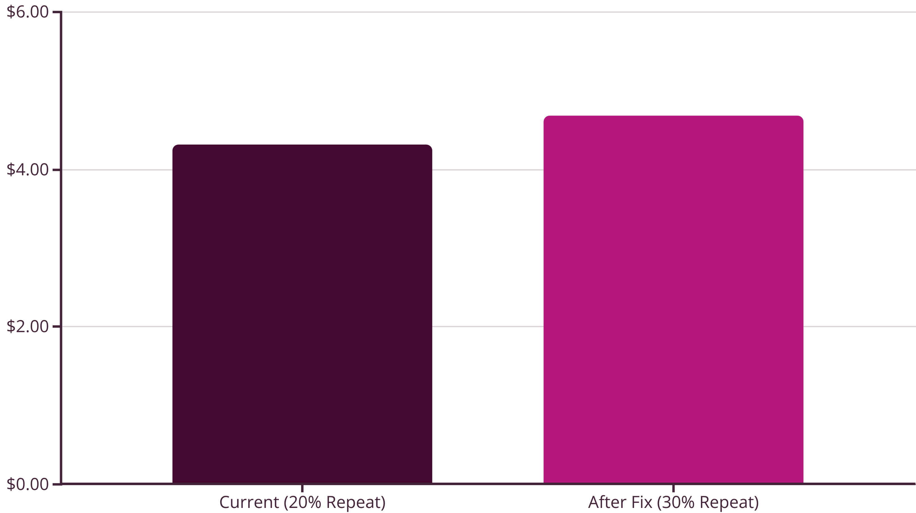
Business Impact: The Power of Improved Repeat Rates
Let's quantify the potential financial uplift from even a modest improvement in the repeat purchase rate, demonstrating the significant business impact of the proposed strategic interventions. This simulation underscores that focusing on retention and engagement yields tangible revenue gains.
Simulation Assumptions:
Monthly Active Users (MAU) = 1,00,000
First Order Conversion Rate = 30%
Average Order Value (AOV) = ₹1200
Repeat Purchase Rate: Current = 20%; After Strategic Fix = 30%
Current Scenario (20% Repeat Rate):
After Strategic Fix (30% Repeat Rate):
Incremental Revenue Gain: ₹36 Lakhs in monthly incremental revenue.
This conservative simulation highlights that even a modest 10% improvement in the repeat purchase rate can lead to a substantial ₹36 Lakhs in additional monthly revenue. This gain, though significant, represents merely the foundational impact. With the compounding effects of improved UX, intelligent product segmentation, and an enriched creator-led commerce ecosystem, the long-term upside potential for Nykaa is projected to be exponentially higher. This reinforces the critical importance of shifting focus from pure acquisition to sustained retention and engagement.

Slide 8
The Future of Nykaa: Beyond Transactions to a Curated Ecosystem
In conclusion, Nykaa's strategic imperative is to transcend its current identity as a mere transactional e-commerce platform and evolve into a dynamic, curated beauty and fashion ecosystem. This evolution demands a delicate balance—one that seamlessly integrates convenience with inspiration, reconciles price sensitivity with an aspirational brand experience, and champions D2C brand support alongside premium luxury curation.
“Don’t just sell products. Curate rituals. Build identity. Enable discovery.”
In a global market increasingly saturated with beauty choices and retailers, consumers are no longer solely seeking a storefront; they are seeking a compelling reason to stay, explore, and return. Nykaa's next phase of growth and leadership hinges on its ability to forge an emotional, aspirational, and consistently rewarding relationship with its user base. By focusing on fostering deeper engagement, providing meaningful discovery pathways, and empowering its diverse brand partners, Nykaa can solidify its position as the ultimate destination for beauty and lifestyle in India.

